Slide 1



hollywood
View in Power BI
Last data refresh:
9/13/2022 4:03:00 PM UTC
Downloaded at:
9/13/2022 4:10:15 PM UTC

Slide 2
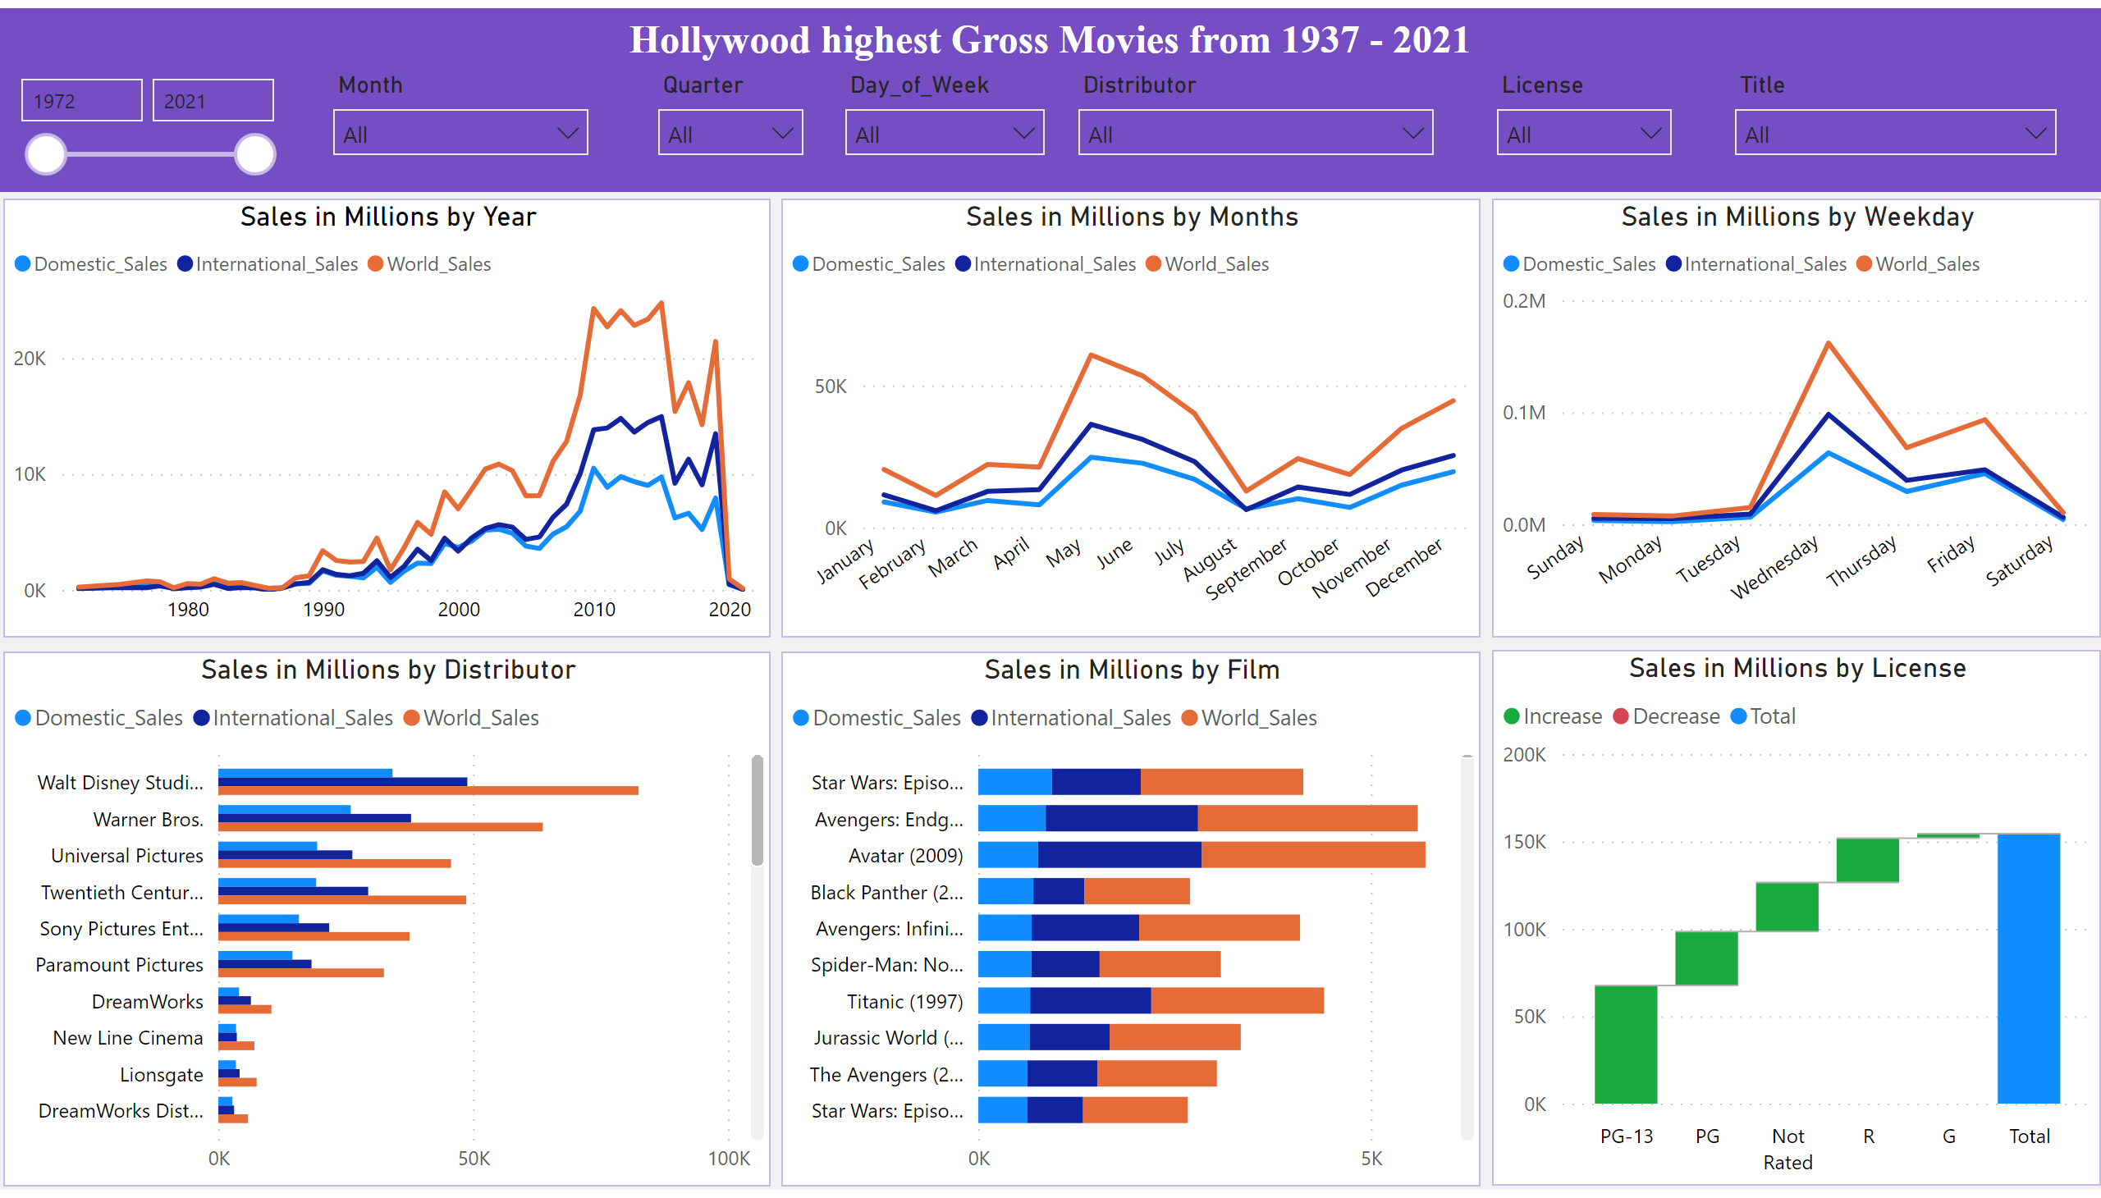
Dashboard
Notes:
textbox
No alt text provided
clusteredBarChart
No alt text provided
lineStackedColumnComboChart
No alt text provided
Sales in Millions by Year
No alt text provided
Sales in Millions by Months
No alt text provided
Sales in Millions by Weekday
No alt text provided
Sales in Millions by License
No alt text provided
Sales in Millions by Distributor
No alt text provided
Sales in Millions by Film
No alt text provided
slicer
No alt text provided
slicer
No alt text provided
slicer
No alt text provided
slicer
No alt text provided
slicer
No alt text provided
slicer
No alt text provided
slicer
No alt text provided

